Slide 1
Part B

Slide 2
Mirror and door

Slide 3
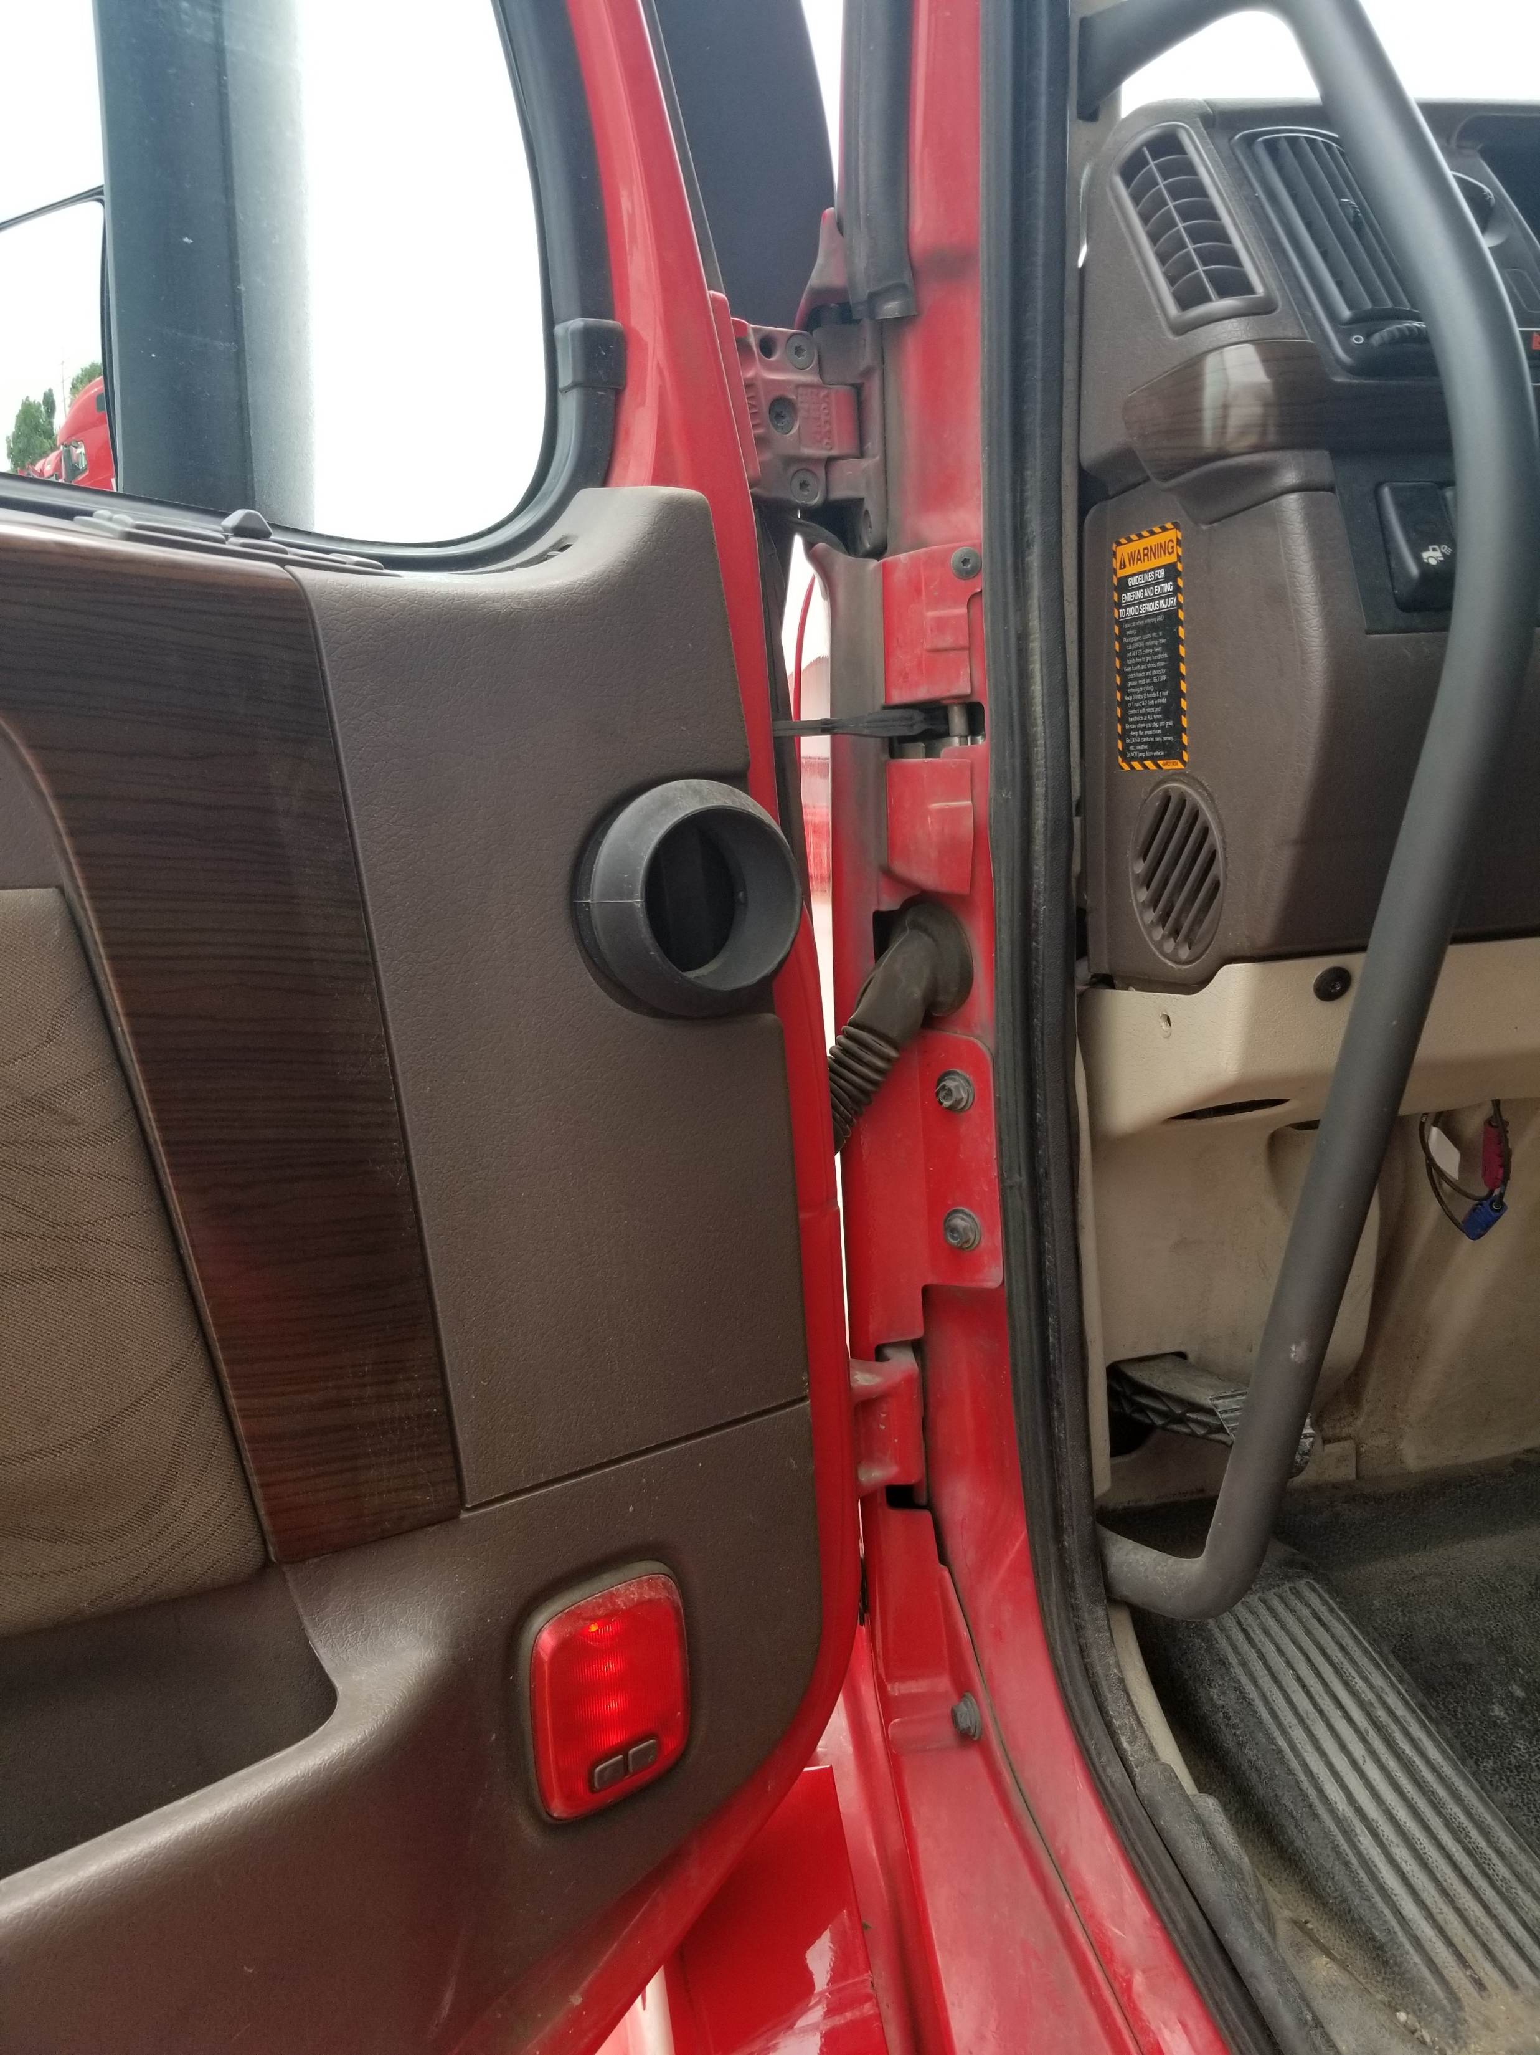
Open the door and check rubber seal and hinges.

Slide 4
Steps

Slide 5
Side marker light / Turn Signal / Hazard

Slide 6
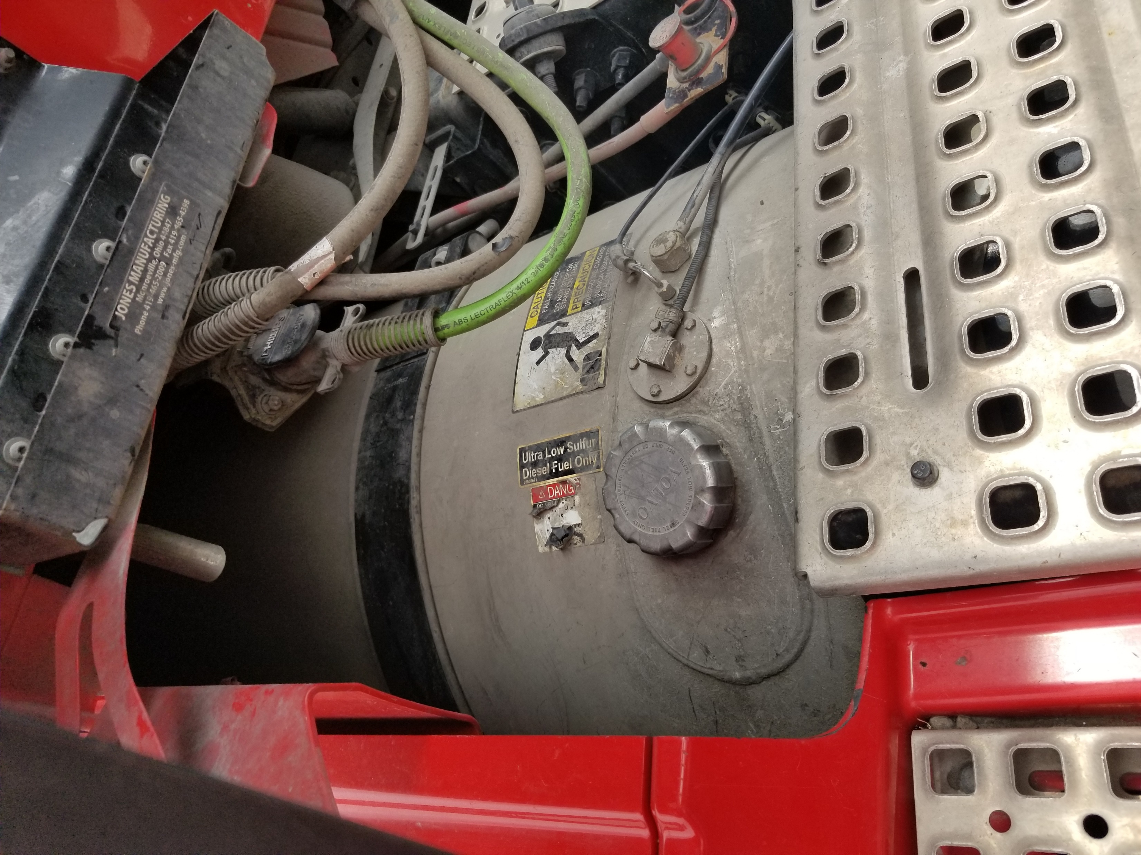
Fuel tank. Check for leaks under the vehicle. Then check cap, rubber seal, straps.

Slide 7
Catwalk with steps

Slide 8
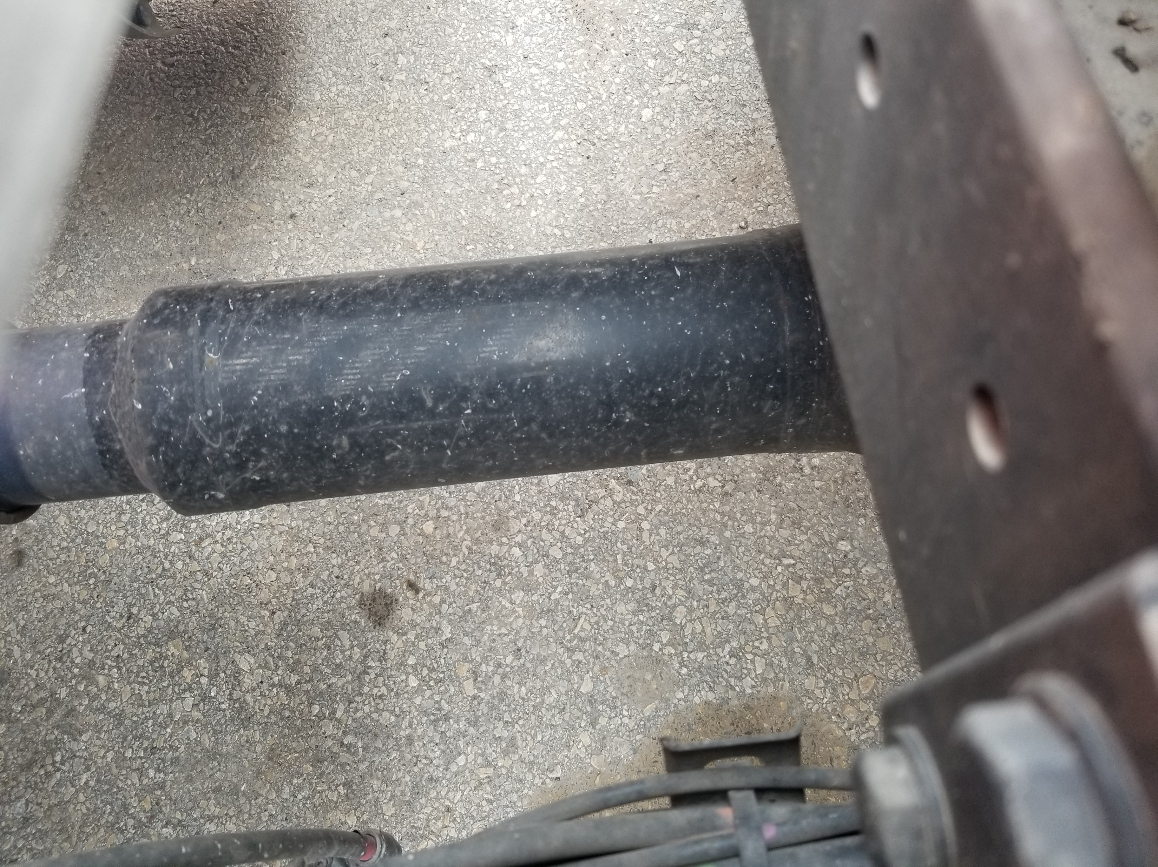
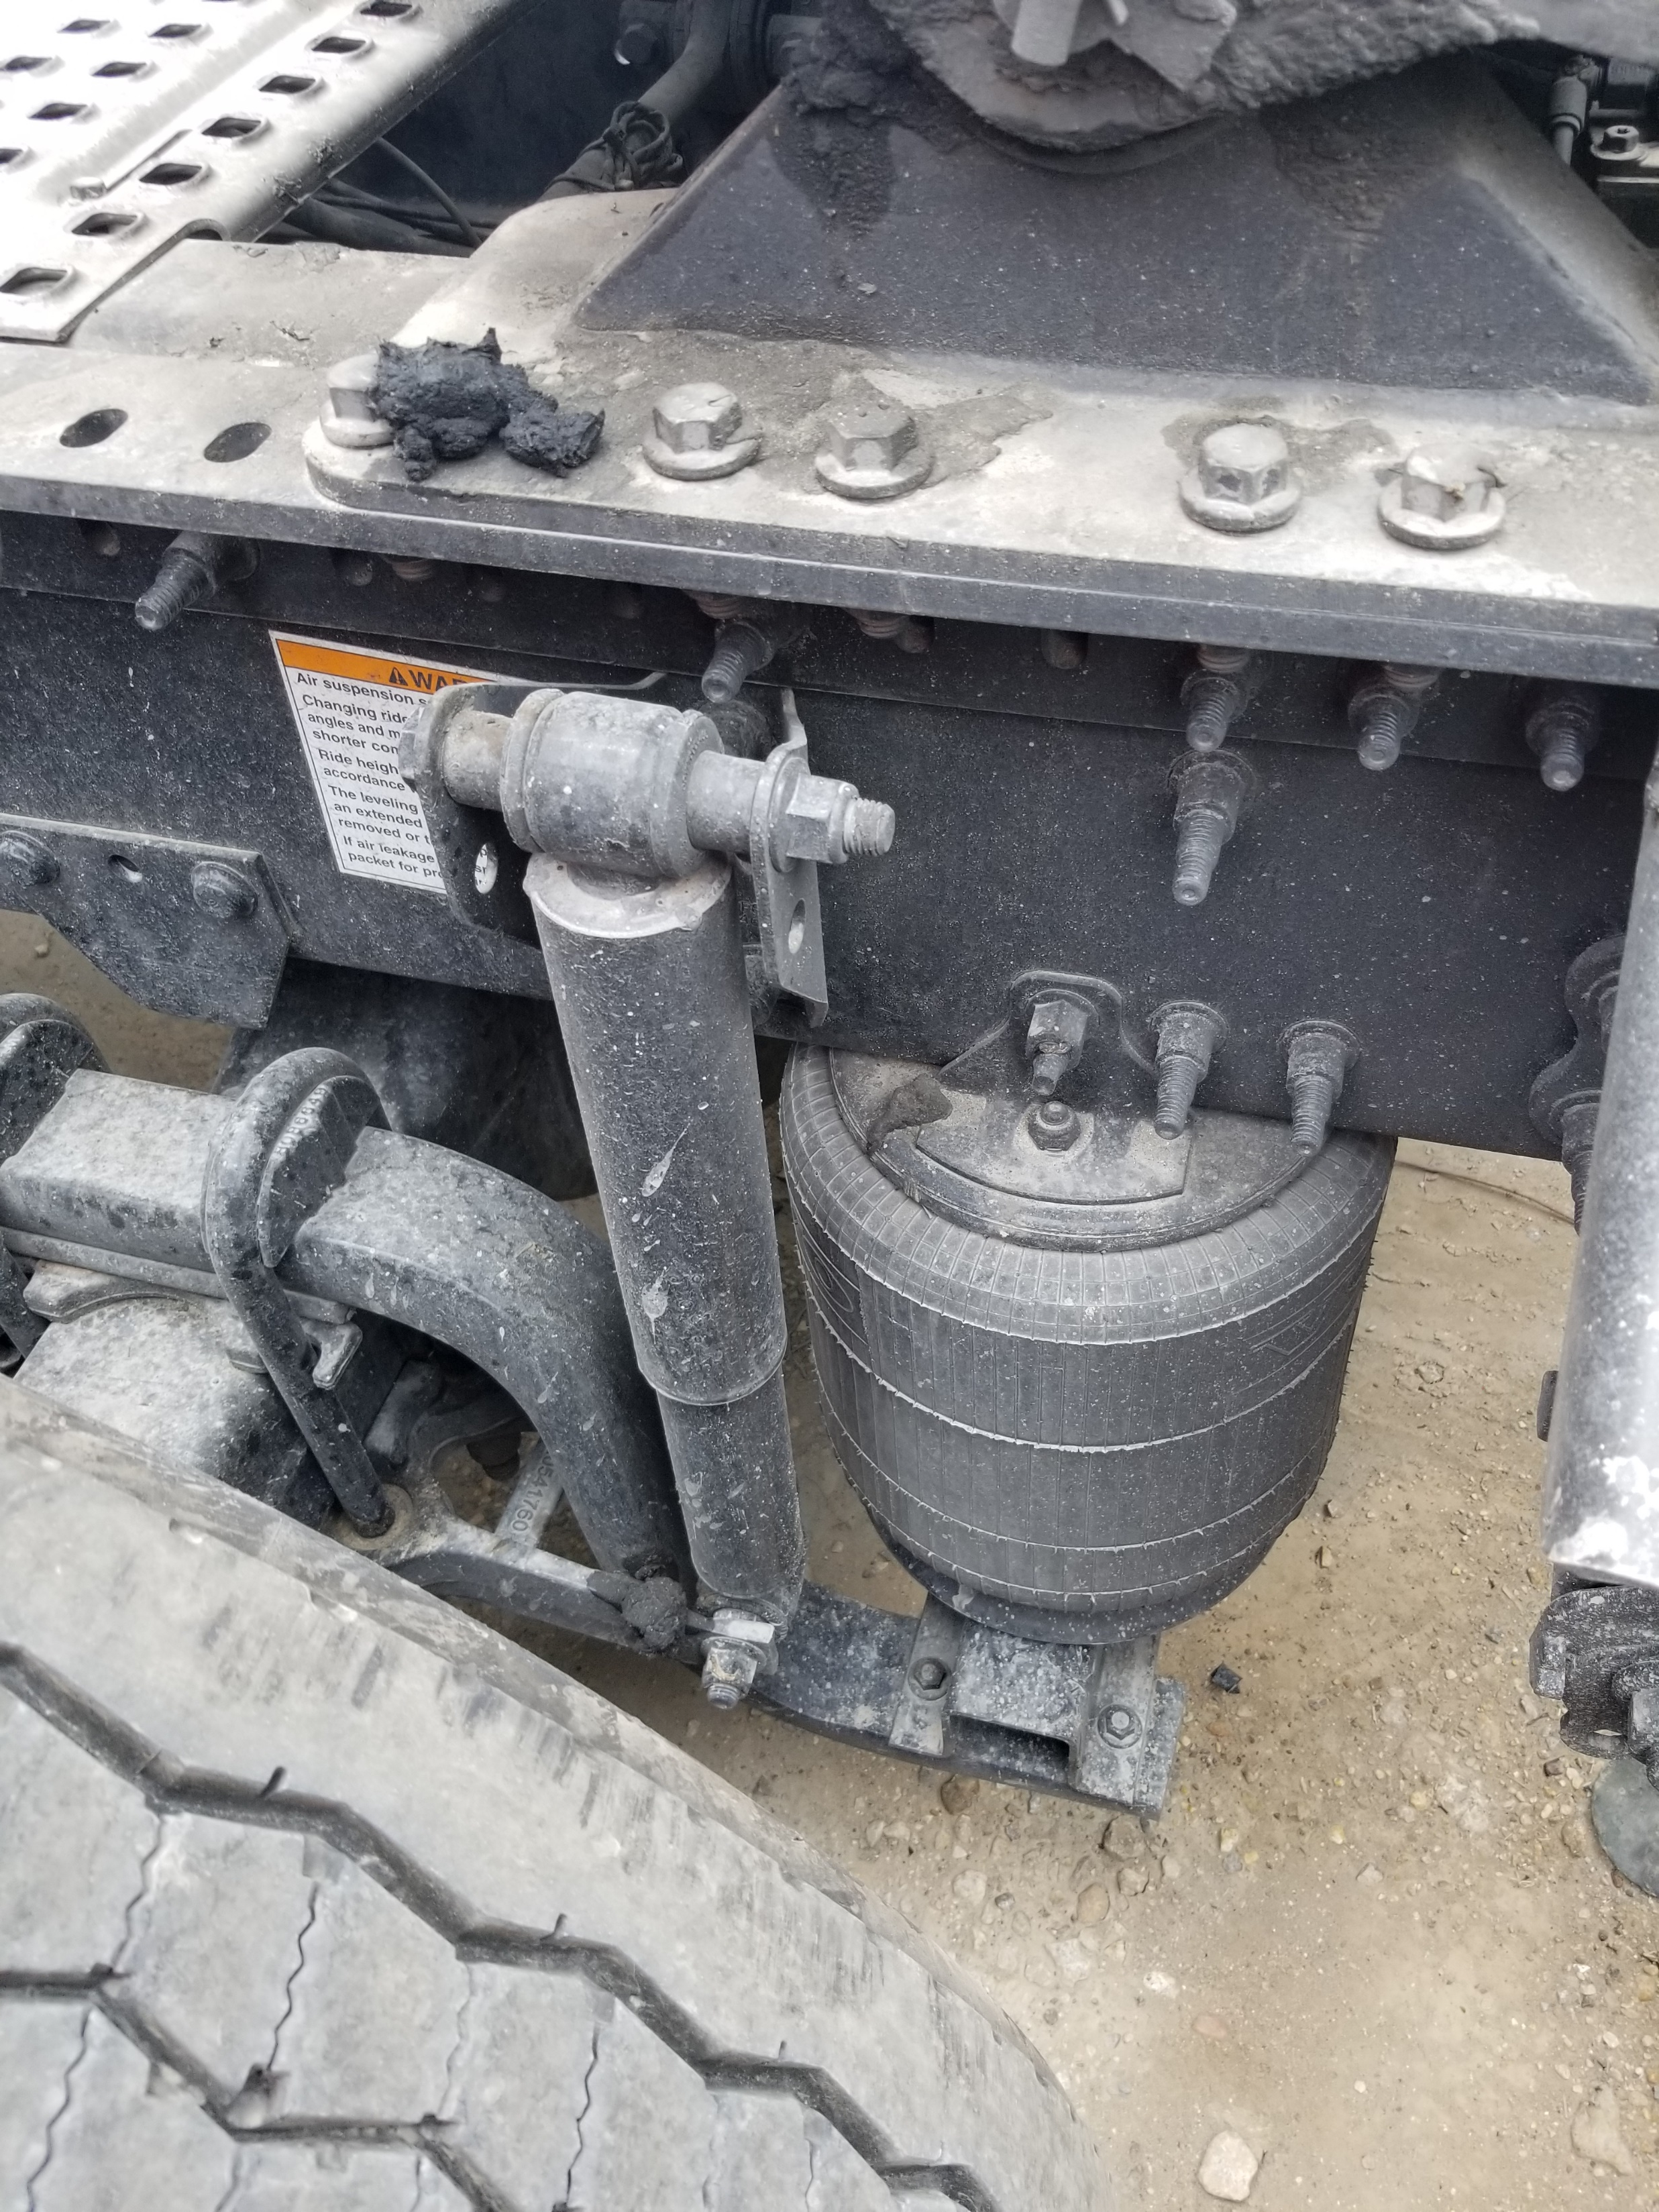
Exhaust, drive shaft and frame

Slide 9
Splashguard

Slide 10
Axle section. Start with the wheel. Inspect the tire first, then rim, lug nuts and hub or axle seal.

Slide 11
Brakes. Rotor, pad, caliper…

Slide 12
… brake chamber and hoses.

Slide 13
Suspension: Torque arm mount, torque arm, bushing, u-bolts…

Slide 14
… shock and upper and lower mounts. Air bag w/ upper and lower mounts

Slide 15
Mud flap and reflector tape

Slide 16
Rear lights: Parking lights, brake lights, turn signals and hazards

